Slide 1




Efficient Privacy Preserving Nearest Neighboring Classification from Tree Structures and Secret Sharing
Jhe-Kai Yang
Department of Computer Science and Engineering
Yuan Ze University, Taiwan
Joint work with Kuan-Chun Huang, Cheng-Yang Chung, Yu-Chi Chen, Ting-Wei Wu (YZU)
Notes:
Conference: IEEE ICC 2022

Slide 2
Outline
Introduction
Proposed Method
Experimental Results
Conclusions
Notes:
Here is my outline. Later I will briefly mention the problem in introduction. Then, move to our method, show the results, and give some conclusions.

Slide 3
Outline
Introduction
Proposed Method
Experimental Results
Conclusions
Notes:
Let’s start with the background and motivation.

Slide 4
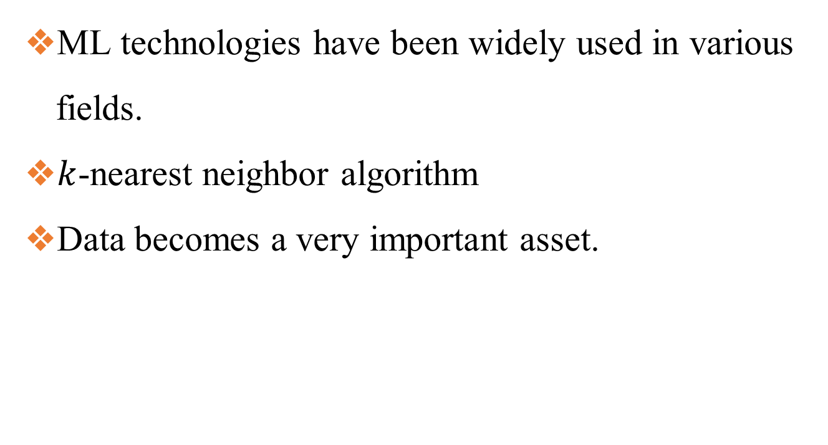
Research background and motivation
ML technologies have been widely used in various fields.
$k$-nearest neighbor algorithm
Data becomes a very important asset.
Notes:
Nowadays, machine learning have been widely used in various fields. And kNN is one of the most common way to classify unknown data with an existing dataset. However, data have become a more important asset for company to utilize. So, it is necessary to protect the data while kNN classification.

Slide 5
𝑘 Nearest Neighbor
A query data will be classified as the data nearby.
Calculate the data distance of the whole dataset and the label of the k nearest data will be considered.
?
Notes:
kNN is a simple way to classify the data by looking the data beside. For the figure below, the green circle is the query data. Then, we should calculate the distances from the green circle to all the other data. And finally, we can know the k closest data may be the dash green circle and the green circle would probably be classified as the major neighbor blue triangle.

Slide 6
Scenario
Classification Service K
Dataset D
Query data x
Classification result K(D, x)
x
K(D, x)
Client: Query
Server: Dataset
Notes:
Then, here is our scenario. The client will like to get the classification service with the dataset in the server. However, the server is not a trusted party. And the client may also try to obtain the dataset D . By the way, in the traditional ML we use a model for the prediction, but in kNN algorithm dataset can just be seen as its model.

Slide 7
Security for the above scenario
D and x should not be revealed to each other.
D should be run with each x.
The client and server should learn no information.
Notes:
Here are the security requirements for the above scenario. First, the dataset D and query data x should be a private information for server and client. Second, the dataset D should be run with each x in the query. Lastly, the client and the server should not learn any information when running kNN.

Slide 8
Main contributions
Privacy-preserving kNN between two parties
Security with lightweight primitives
Accuracy without extremely drop
Efficiency improvement
Notes:
And here is our's main contributions. We proposed a privacy-preserving kNN between two parties. And use secret sharing as a lightweight primitives. Then, our solution can maintain the accuracy while improving the efficiency.

Slide 9
Outline
Introduction
Proposed Method
Experimental Results
Conclusions
Notes:
Next, we will move on to our’s solution.

Slide 10
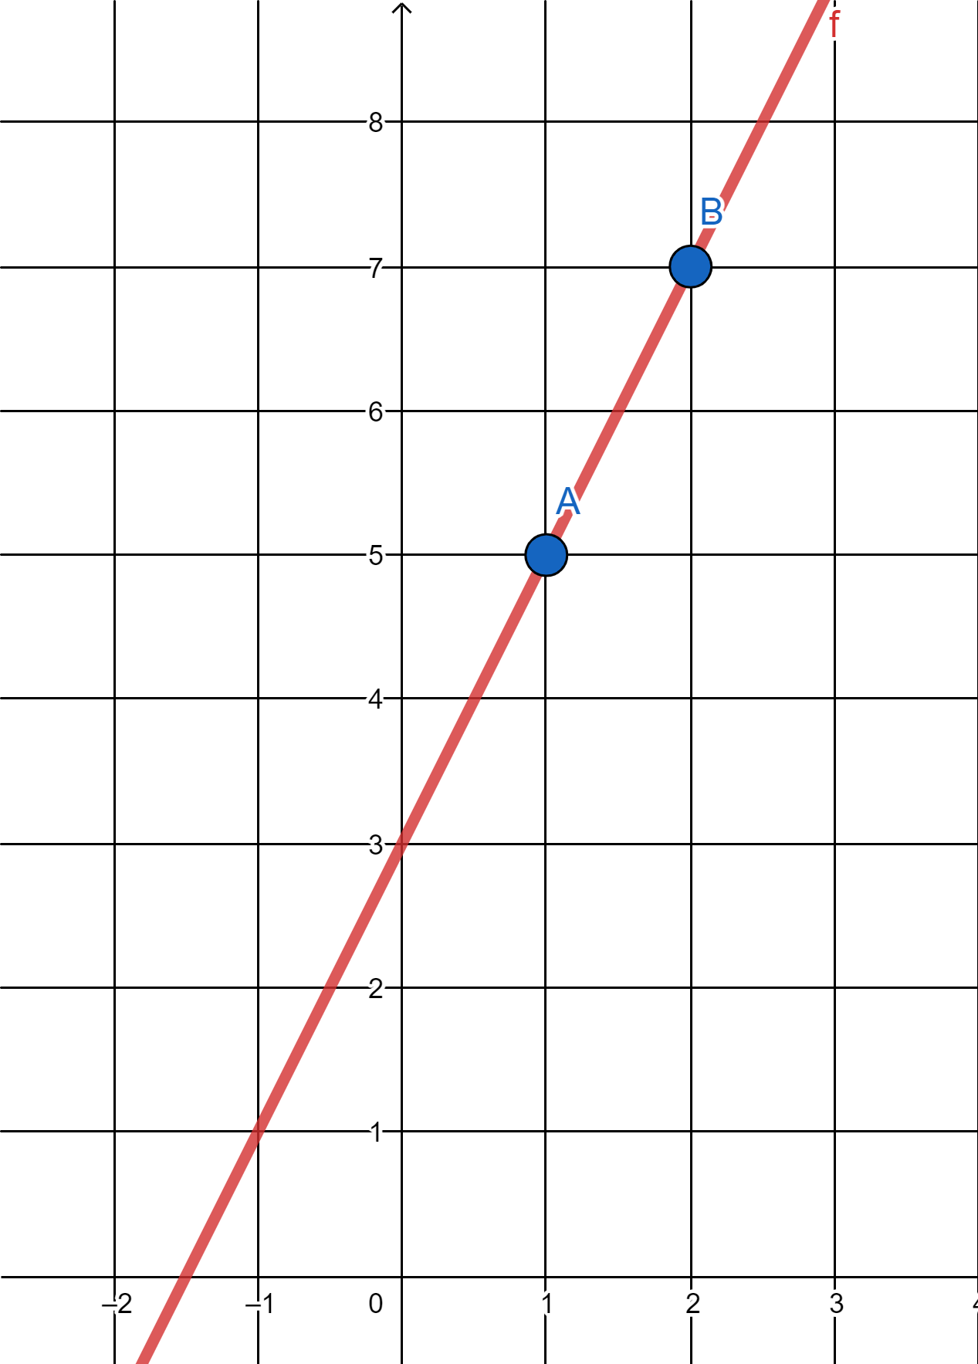






Preliminaries - Secret Sharing
$$y=2x+3$$
2-out-of-2 Secret Sharing
$y=ax+b$
Algorithms
Share(s) → [s]₁, [s]₂
Recover([s]₁, [s]₂) → s
$$(2, 7)$$
$$(1, 5)$$
$${[3]}_{1}=5$$
$${[3]}_{2}=7$$
Notes:
Before we talk about the specific method. Let's looks the preliminary. Secret sharing is a lightweight cryptographic primitives to achieve privacy-preserving. Here we focus on the 2-out-of-2 secret sharing to build the calculation between two parties. To put it simply, 2-out-of-2 secret sharing has an equation. (y equals a x plus b) Then the Share algorithm can hide the secret in the constant b, and share the point of the equation. For example, we randomly choose $a$ of the equation and build a line to hide the secret 3. Then, we can get the two points (1,5) and (2,7) as the share one and share two of 3. And with the shares, the Recover algorithm can rebuild the equation and return the hidden secret.

Slide 11





Flow chart
4. Randomly generate 𝑎, 𝑏, 𝑎𝑏 when protocol requires.
5. Split 𝑎, 𝑏, 𝑎𝑏 into [𝑎]1, [𝑎]2, [𝑏]1 [𝑏]2, [𝑎𝑏]1, [𝑎𝑏]2
Randomness Generator (RG)
6. Send [𝑎]2, [𝑏]2, [𝑎𝑏]2 to client.
6. Send [𝑎]1, [𝑏]1, [𝑎𝑏]1 to server.
2. Send ${\text{[}\text{Q}\text{]}}_{1}$ to server.
Client
2. Send ${\text{[}\text{D}\text{]}}_{2}$ to client.
Server
1. Split Q into ${\text{[}\text{Q}\text{]}}_{1} , {\text{[}\text{Q}\text{]}}_{2}$ .
7. Send the classification result to client.
1. Split D into ${\text{[}\text{D}\text{]}}_{1} , {\text{[}\text{D}\text{]}}_{2}$ .
3. Run protocol with server.
3. Run protocol with client.
Notes:
This is a flow chart of our construction. First, client and server split their data into shares. Second, exchange the shares. Third, run the protocol to calculate shares. Then, here is a trusted third-party RG to help distribute randomness share for client and server whenever the protocol needs. At last, the server will return the classification result to the client.

Slide 12
Construction - Tools
Secure Secret Sharing Multiplication
Secure Comparison
Positive Difference
Secure Sort
SSSM
SC
PD
SS
Notes:
In our construction, we have these tools. Since the construction is 2-out-of-2 computation, we will have two-party to interact in the following protocol.

Slide 13
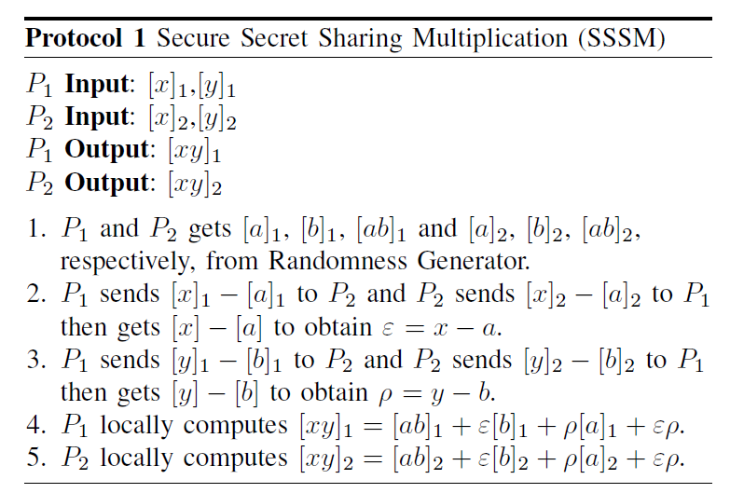










Construction - Tools - Secure Secret Sharing Multiplication
$$P_{1}:2$$
$$P_{2}:3$$
${\left[2\right]}_{1}$,
$${\left[2\right]}_{2}$$
$${\left[3\right]}_{1}$$
$$,{\left[3\right]}_{2}$$
$${\left[2\right]}_{1} {,\left[3\right]}_{1}$$
$${\left[2\right]}_{2} {,\left[3\right]}_{2}$$
SSSM
$${\left[6\right]}_{1}$$
$${\left[6\right]}_{2}$$
Notes:
Now let’s have an example of a secure secret sharing multiplication that the party 1 with secret 2 and the party two with secret 3. As we just mentioned earlier, they will first make and exchange their shares. Then, party 1 will get the first share of 2 and 3, and party 2 will get the second share of 2 and 3. After computing, they can get the share of the product.

Slide 14
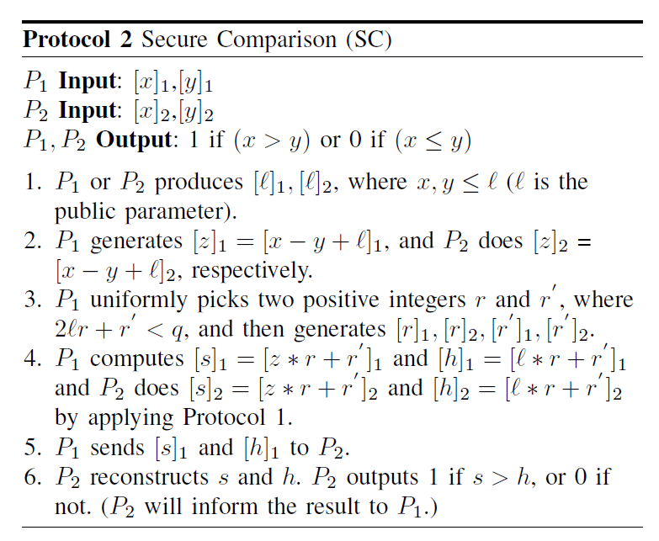






Construction - Tools - Secure Comparison
$$P_{1}:2$$
$$P_{2}:3$$
$${\left[2\right]}_{1} {,\left[3\right]}_{1}$$
$${\left[2\right]}_{2} {,\left[3\right]}_{2}$$
SC
$$0$$
$$0$$
Notes:
Secure Comparison is used to compare whether the x is greater or less than y. It will output a boolean result, whether 1 if x is greater than y, or 0 for otherwise.

Slide 15
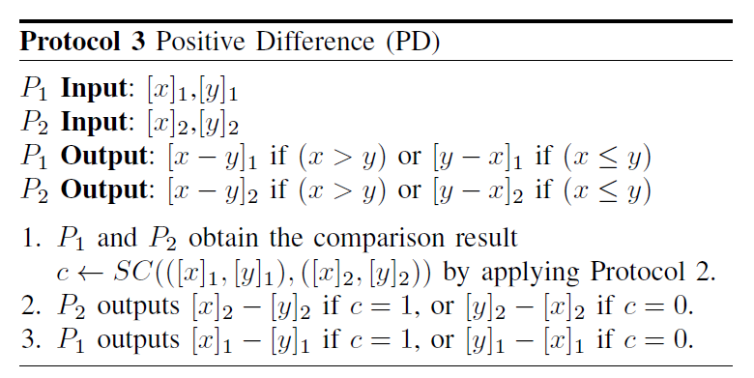






Construction - Tools - Positive Difference
$$P_{1}:2$$
$$P_{2}:3$$
$${\left[2\right]}_{1} {,\left[3\right]}_{1}$$
$${\left[2\right]}_{2} {,\left[3\right]}_{2}$$
PD
$${\left[3−2\right]}_{1}$$
$${\left[3−2\right]}_{2}$$
Notes:
With the Secure Comparison, we can easily get the positive difference for calculating the distance.

Slide 16
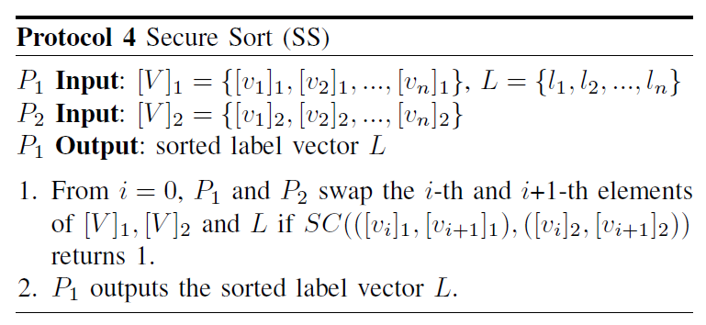


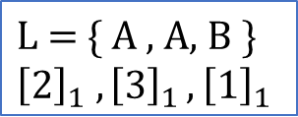
Construction - Tools - Secure Sort
$$\text{L}\text{ = \{ }\text{A}\text{ , }\text{A}\text{, }\text{B}\text{ \}}$$
$${\left[2\right]}_{1} {,\left[3\right]}_{1}, {\left[1\right]}_{1}$$
$${\left[2\right]}_{2} {,\left[3\right]}_{2} , {\left[1\right]}_{2}$$
SS
$$\text{\{ }\text{B}\text{ , }\text{A}\text{, }\text{A}\text{ \} }$$
Notes:
And also with the Secure Comparison, we can make a Secure Sort for the label without revealing the calculation result.

Slide 17



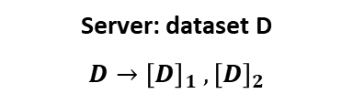
Main Protocol
Converting and exchanging shares
$${\left[Q\right]}_{1}$$
$${\left[D\right]}_{2}$$
Client: query Q
$$Q→{\left[Q\right]}_{1} , {\left[Q\right]}_{2}$$
Server: dataset D
$$D→{\left[D\right]}_{1} , {\left[D\right]}_{2}$$
Notes:
Now let’s complete our main protocol with the tools. First of all, the server and client convert their data into shares. And pass one of the share to the other.

Slide 18

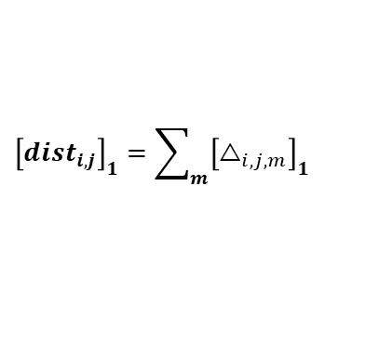
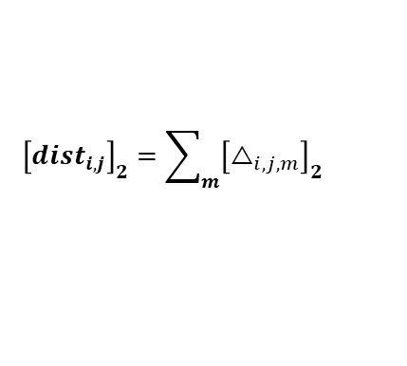

Main Protocol
Calculate distance between each pair of instances
Client: ${\left[D\right]}_{2} ,{\left[Q\right]}_{2}$
$${\left[D\right]}_{2}→{\left[d_{i}\right]}_{2}→{\left[<d_{i}>_{m}\right]}_{2}$$
$${\left[Q\right]}_{2}→{\left[q_{j}\right]}_{2}→{\left[<q_{j}>_{m}\right]}_{2}$$
Server: ${\left[D\right]}_{1} , {\left[Q\right]}_{1}$
$${\left[D\right]}_{1}→{\left[d_{i}\right]}_{1}→{\left[<d_{i}>_{m}\right]}_{1}$$
$${\left[Q\right]}_{1}→{\left[q_{j}\right]}_{1}→{\left[<q_{j}>_{m}\right]}_{1}$$
PD
$${\left[dist_{i,j}\right]}_{2}=\sum_{m}{{\left[△_{i,j,m}\right]}_{2}}$$
$${\left[dist_{i,j}\right]}_{1}=\sum_{m}{{\left[△_{i,j,m}\right]}_{1}}$$
Notes:
Then, a PD protocol is used to calculate the positive difference of the m-th attribute in the pair of the i-th instance in dataset and the j-th instance in query. After the sum, we can obtain the distances of each query data with the whole dataset.

Slide 19
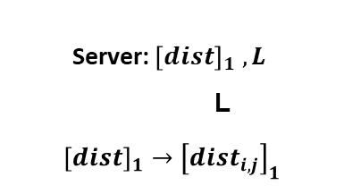
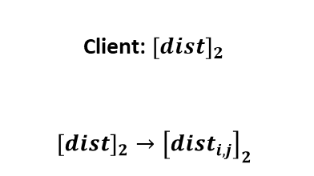
Main Protocol
Sort the label and get the result
Client: ${\left[dist\right]}_{2}$
$${\left[dist\right]}_{2}→{\left[dist_{i,j}\right]}_{2}$$
Server: ${\left[dist\right]}_{1} , L$
L
$${\left[dist\right]}_{1}→{\left[dist_{i,j}\right]}_{1}$$
SS
L’
Classification result
= Majority label of top-k in L’
Notes:
So, a SS protocol is used to get the k nearest label for each query data. And finally, the server will return the classification result to the client.

Slide 20

Improving Efficiency
PP$k$NN is not rapid enough.
Data preprocessing
Tree-based Method
Decision Tree-based Method
Notes:
Although our's privacy-preserving kNN with secret sharing works efficiently, it still take lots of time on a big dataset. So, we introduce some way of data preprocessing to improve PPkNN.

Slide 21
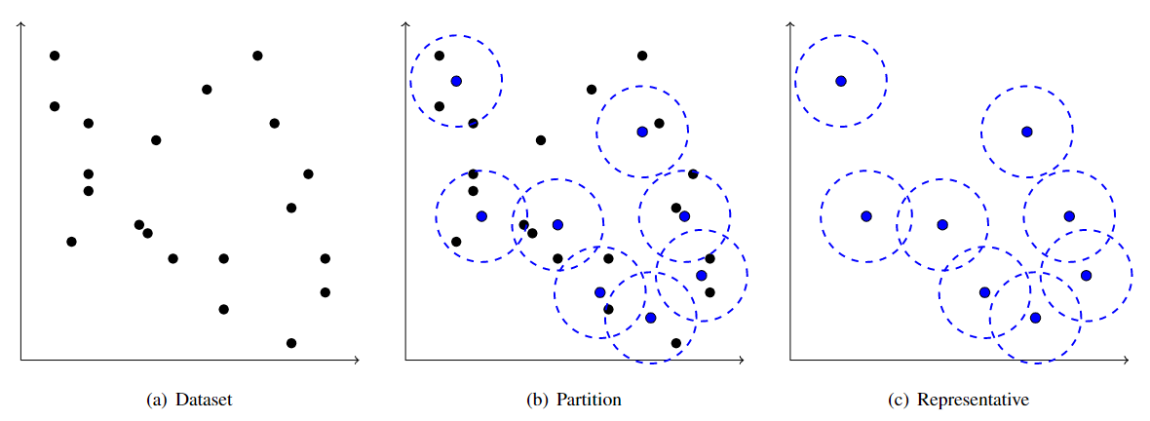
Partition
Reduce calculation burden by a smaller area in the dataset.
Notes:
First of all, we randomly choose some points and divide some smaller area of the dataset. Then, we can reduce the calculation burden by PPkNN on just a partition area.

Slide 22
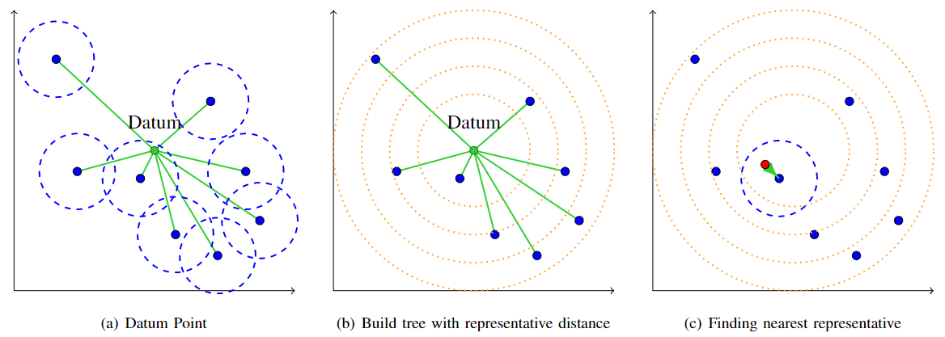
Tree-based Method
Build a tree structure for the nearest representative search with the datum point.
Notes:
So, the next step is to build a tree structure for finding the nearest partition area. Here we give a tree-based method with a datum point to define a tree with the sorted representative distances. Then, with the Secure Comparison, the query data can find a partitioned area on the leaf.

Slide 23
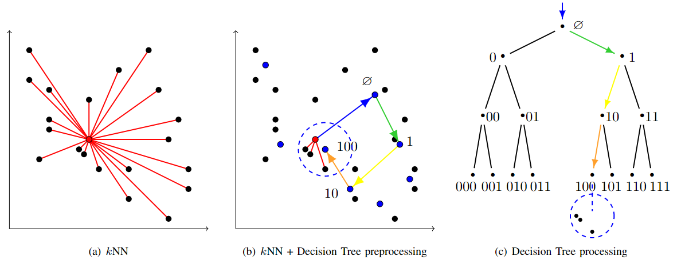
Decision Tree-based Method
However, the datum point may not be suitable for all query data.
So, we build a decision tree to get a representative more similar to the query data.
Notes:
However, we found that the tree-based method has accuracy problems, so we changed to constructing a decision tree as the solution. The decision tree-based method give a series of decisions for finding a representative more similar to the query data. Finally, we can get a representative with the decision tree structure and reduce the PPkNN calculation burden with a smaller area.

Slide 24
Outline
Introduction
Proposed Method
Experimental Results
Conclusions
Notes:
Next, let’s go to the experimental results.

Slide 25
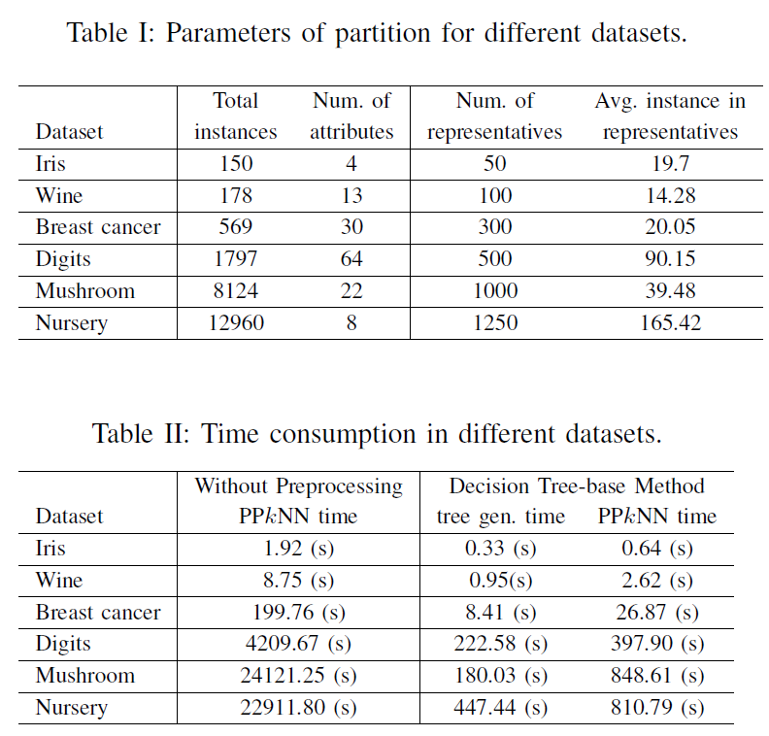
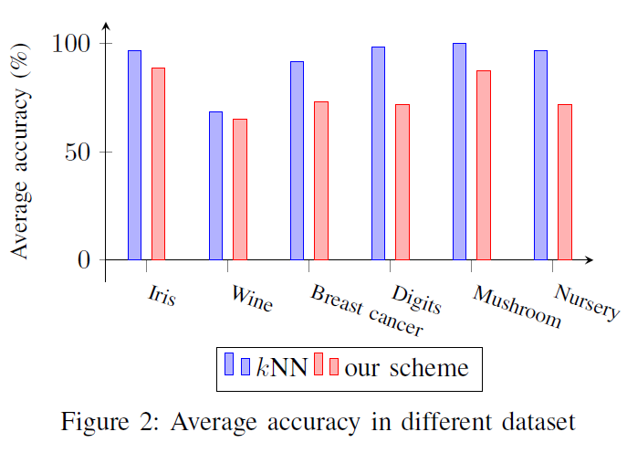
Analysis
Notes:
We test our scheme on some UCI datasets with the partition above. The following is the execution time and accuracy in different datasets. As we can see, without preprocessing it takes more than 6 hours for about ten thousand instances and only needs 15 minutes with the decision tree-based method while maintaining a certain degree of accuracy.

Slide 26
Outline
Introduction
Proposed Method
Experimental Results
Conclusions
Notes:
Finally, we make some conclusions.

Slide 27
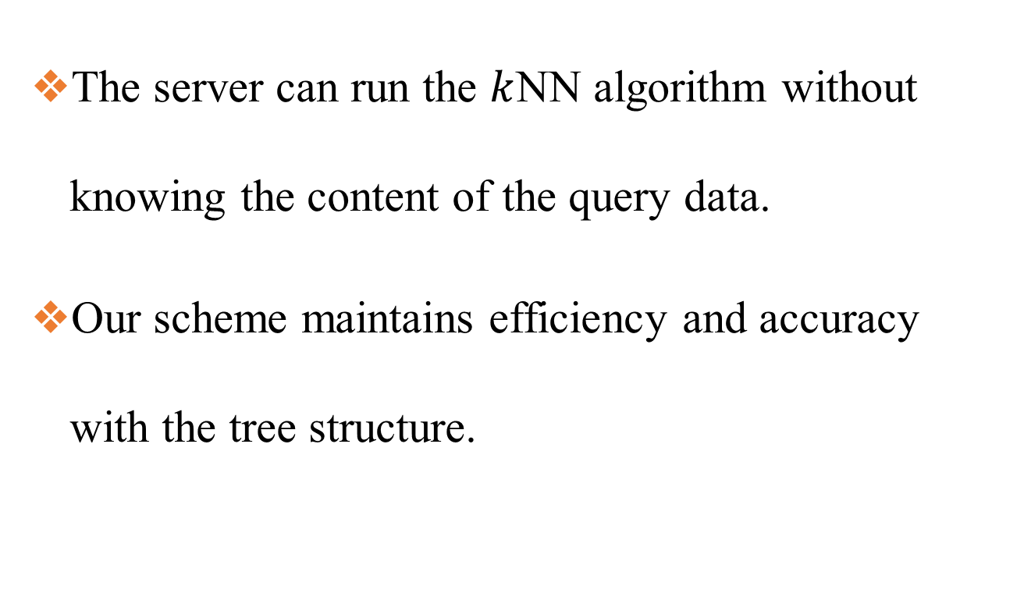
Guarantees
The server can run the $k$NN algorithm without knowing the content of the query data.
Our scheme maintains efficiency and accuracy with the tree structure.
Notes:
This paper has the following guarantees. The server can run the 𝑘NN algorithm without knowing the content of the query data. Our scheme maintains efficiency and accuracy with the tree structure.

Slide 28
Thanks for Listening
Notes:
Thanks for watching my presentation, goodbye.

